Slide 1
Introduction
To
AR Models

Slide 2
Introduction To AR Models
AutoRegressive Model predicts future behaviour based on past behaviour.
It is used when there is some correlation between values in a time series and the values that precede and succeed them.
In Autoregression we use a Regression model to formulate a time series problem. We make linear combination of past observations and use them to forecast future observations.

Slide 3
Working of AR Models
We need to forecast a variable called yt.
We need past observations such as yt-1, yt-2, yt-3 etc
The fundamental assumptions of Autoregressive Model:
Stationarity
AutoCorrelation

Slide 4
Stationarity

Slide 5
Stationarity
Stationarity means that the statistical properties of a process generating a time series do not change over time.
The statistical properties are
Mean
Variance
Covariance
These remain same irrespective of the time at which you observe.

Slide 6
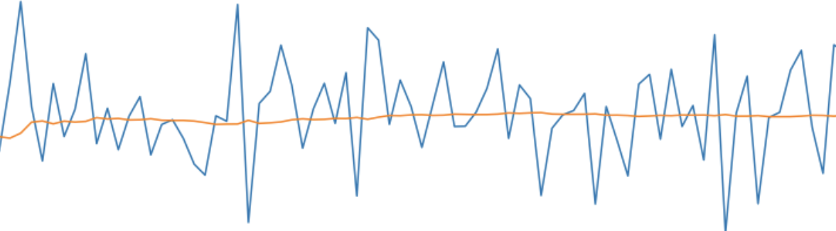
Time Series with Constant Mean
Here, the Blue line is the Time series and Red line is representing the “Mean”.

Slide 7
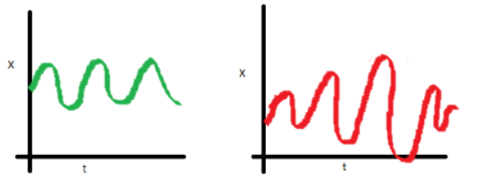
Time Series with Constant Variance and Covariance
Variance is the spread between the data points present within a time series data set.
The Green Line, Represents a Chart with Constant Variance.
The Red Line Represents a Chart with non constant variance.

Slide 8
Why Stationarity is important?
Stationary processes are easier to analyze and model because their statistical properties do not change over time.
If the statistical properties are not constant over time then it is said to be a Non-Stationary Time Series.

Slide 9
Checking for Stationarity

Slide 10
How to Check Stationarity?
There are two popular statistical tests using which we can test the stationarity of a time series.
Augmented Dickey-Fuller(ADF) test.
Kwiatkowski-Phillips-Schmidt-Shin (KPSS) test.

Slide 11
Ad Fuller Test vs KPSS Test
Ad Fuller Test
Null Hypothesis: The time series is not stationary.
Alternate Hypothesis: The time series is stationary.
KPSS Test
Null Hypothesis: The time series is stationary.
Alternate Hypothesis: The time series is not stationary.

Slide 12
Converting Non-stationary into Stationary

Slide 13
Converting Non-stationary into Stationary
There are two tools for converting a non-stationary series into a stationary series:
Differencing
Transformation

Slide 14
Understanding Differencing
Differencing means to calculate the difference between consecutive observations.
Original Time Series | 1st order differencing | 2nd order differencing
60
190 | 130
430 | 240 | 110
780 | 350 | 110
1250 | 470 | 120
1830 | 580 | 110

Slide 15
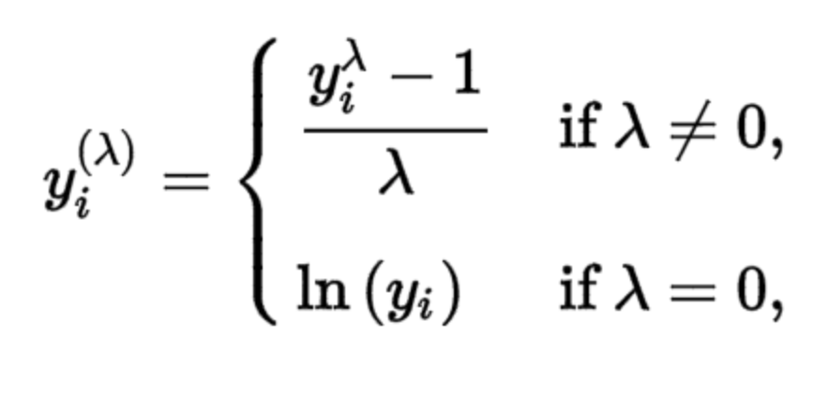
Box Cox Transformation
Box Cox transformation transforms non-normal dependent variables into normal distribution.
The mathematical formula for box cox transformation is shown:

Slide 16
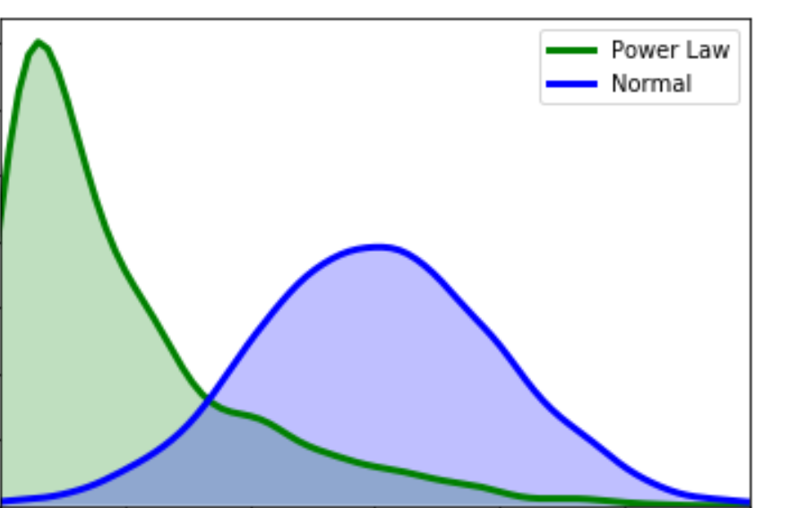
Box Cox Transformation
y is the original time series.
y(λ) is the transformed series.
To find the optimal value of lambda bet -5 and +5 is to minimize the variance of the time series.

Slide 17
Autocorrelation Measures

Slide 18
Autocorrelation Measures
Autocorrelation is the representation of the degree of similarity between a given time series and the lagged version of itself over successive time intervals.
It helps us to know a variable is influenced by its own lagged values.

Slide 19
Autocorrelation
Observations | Lag 1 | Lag 2
34
36 | 34
35 | 36 | 34
37 | 35 | 36
37 | 37 | 35
38 | 37 | 37
39 | 38 | 37
39 | 39 | 38
y(t) --->y(t-1)--->y(t-2)
y(t) --->y(t-2)

Slide 20
Simple Auto-Regressive Model

Slide 21
Simple AutoRegressive Model
Regressive model is used for forecasting future observations based on the past observations.
Model has a parameter p.
p is the maximum number of lags.

Slide 22
Equation for Simple Autoregressive Model
Suppose, the highest order lag is 10.
2nd , 4th and 6th have significant correlation with future observations.
Model equation would be:-
y = β0 + β1*y(t-2) + β2*y(t-4) + β3*y(t-6)
y(t-2), y(t-4) and y(t-6) are the independent variables.

Slide 23
Moving Average Model

Slide 24
Moving Average Model
In Moving Average Model, we consider the past forecasted errors to forecast the future values
The Moving average model has a parameter called “q” which is the size of the Moving average window over which linear combinations of errors are calculated.

Slide 25
Working of Moving Average Model
The mathematical equation is:
y(t) = µ + φ(k)*ε(t-k)
µ is the mean of the series
ε(t-k) is the past forecasted value
φ(k) is the weight associated with error value

